Slide 1
Project – Crypto BOT
GrouP 7
ShaNE
Charlotte
AlBERT
SAIM
MICHEAL

Slide 2
What we SET OUT TO ACHIEVE
Build a BOT that trades based on portfolio risk and pattern recognition with buy and sell signals.

Slide 3

EXECUTIVE SUMMARY
Leveraging Pologon for data for crypto market data and candle stick data.
Maintain archieve data for local data management.
Allow multiple developers to leveage same API Code by using their own Polygon API Keys.
Run various portfolio risk analysis using Monte Carlos Simulation
Candle Stick pattern recognition for complete crypto market.
Script Funtionality to routine download the candle stick for entire market.

Slide 4
LIBRARIES EXPLORED
PYTHON CODES
Monty Forecast Tools
Data Management
Candle Stick Pattern
Market Data
Local Settings
LIBRARIES
TA-LIB
Polygon
tqdm

Slide 5
PROJECT LIMITATIONS
Only 2 years of data available.
Not able to implement real buy and sell triggers to compare buy and sell strategy to buy and hold strategy.

Slide 6
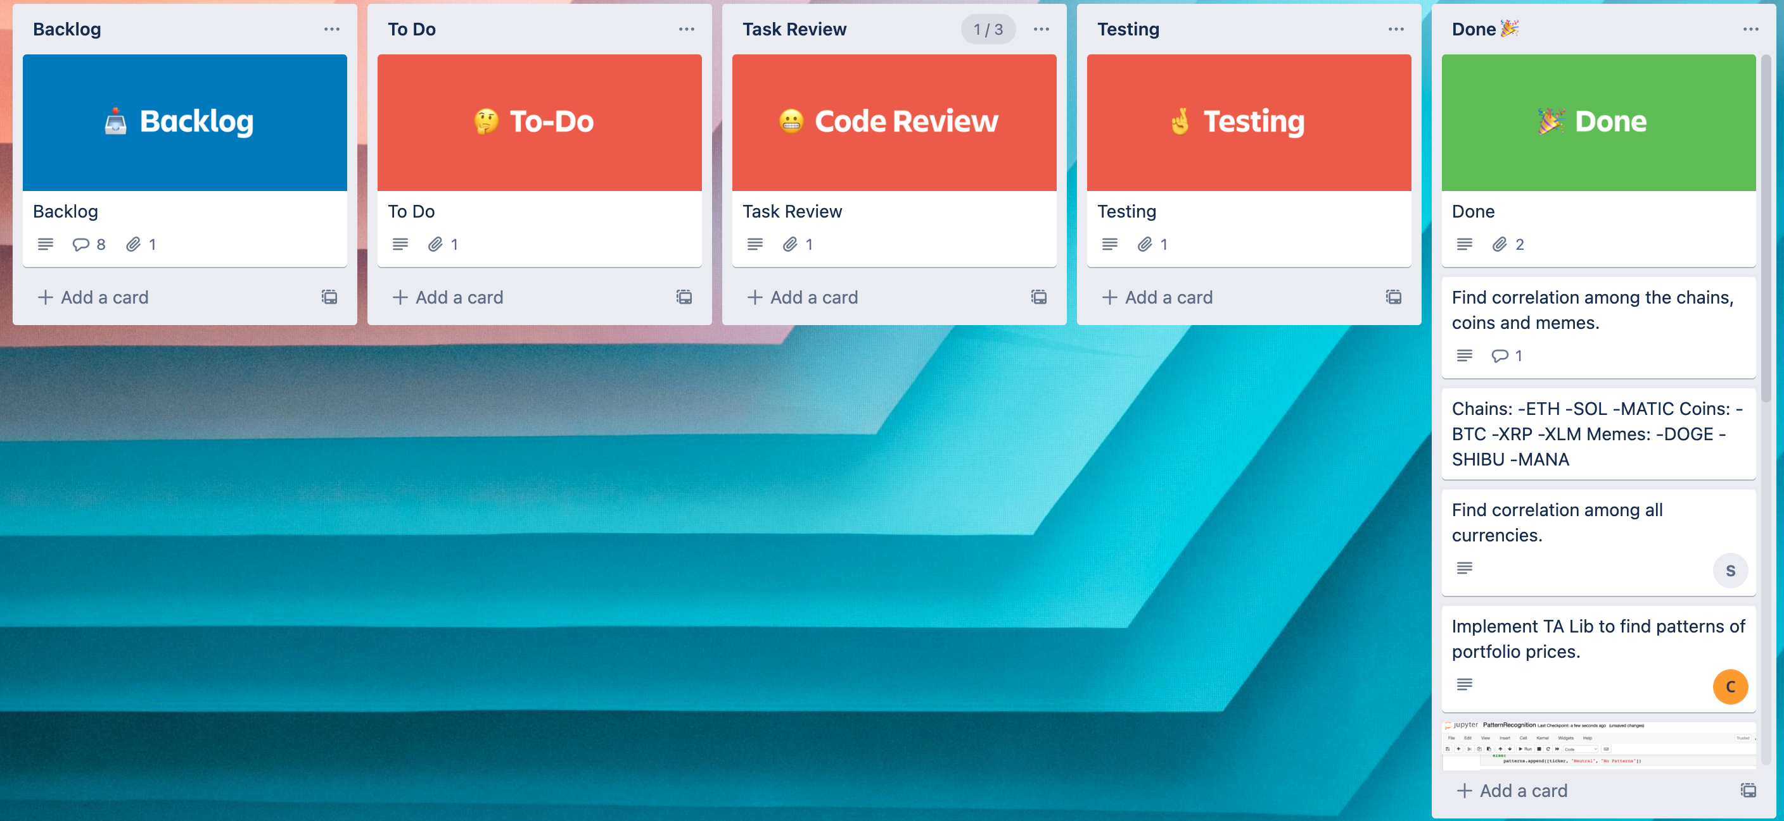
PROJECT MANAGEMENT –TRELLO BOARD

Slide 7
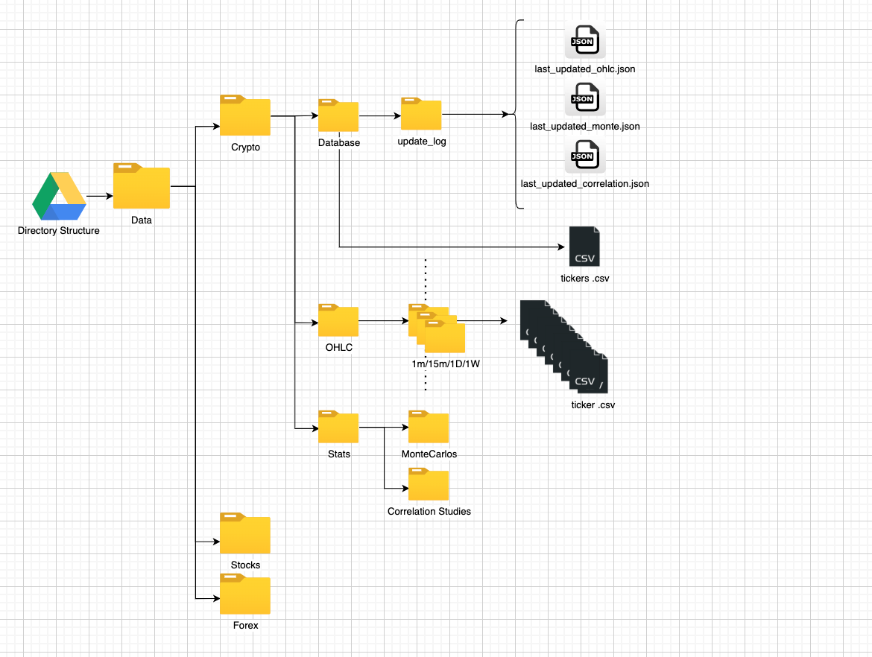
DATA MANAGEMENT

Slide 8

Our JOURNEY
Created 3 Separate Crypto Portfolios Baskets
MEMES - [MANA, SIBU , DOGE]
CHAIN – [ETH, SOL, MATIC]
COIN - [ BTC, XRP, XLM ]

Slide 9
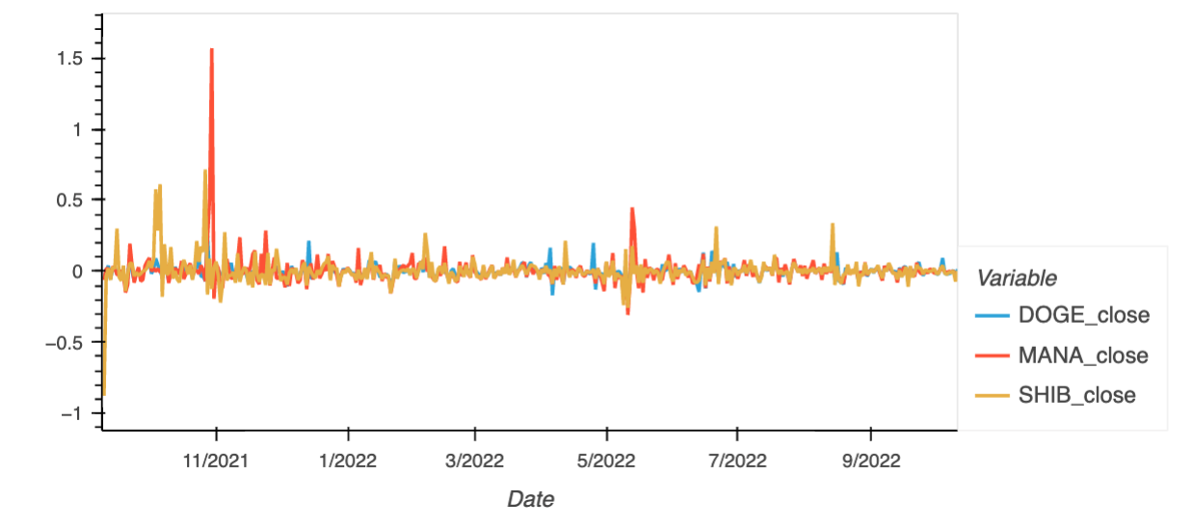
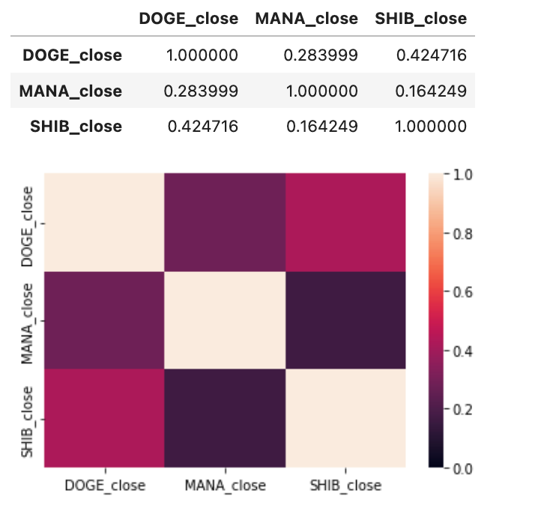
CO-RELATION of BASKETS - MEMES

Slide 10
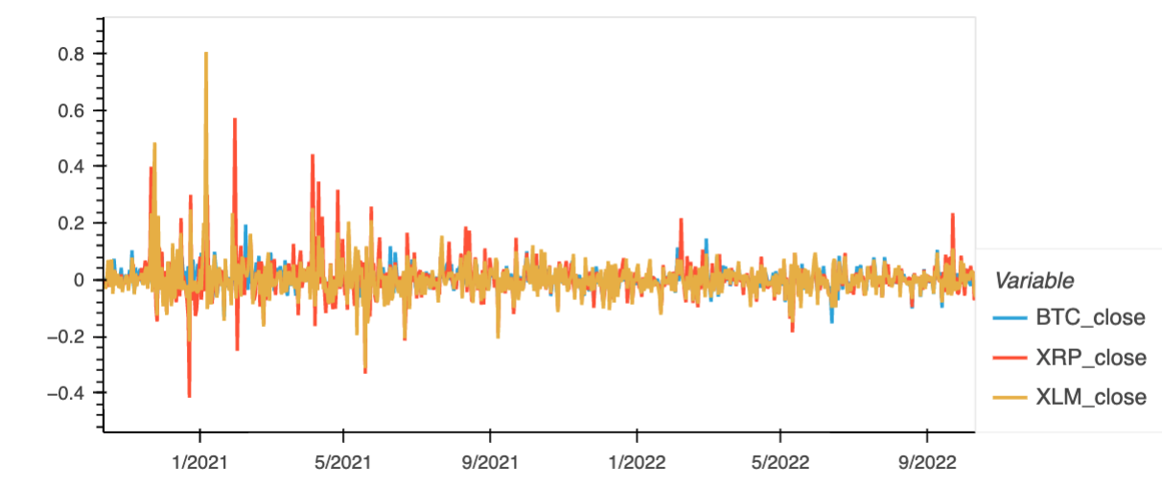
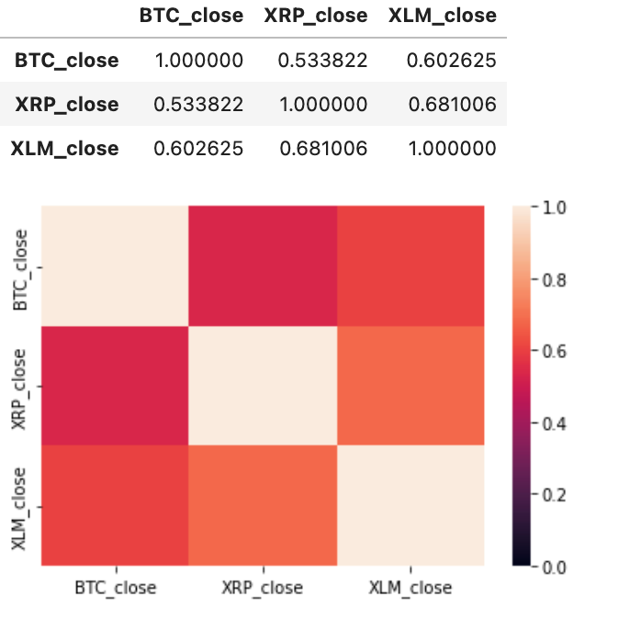
CO-RELATION of BASKETS -COIN

Slide 11
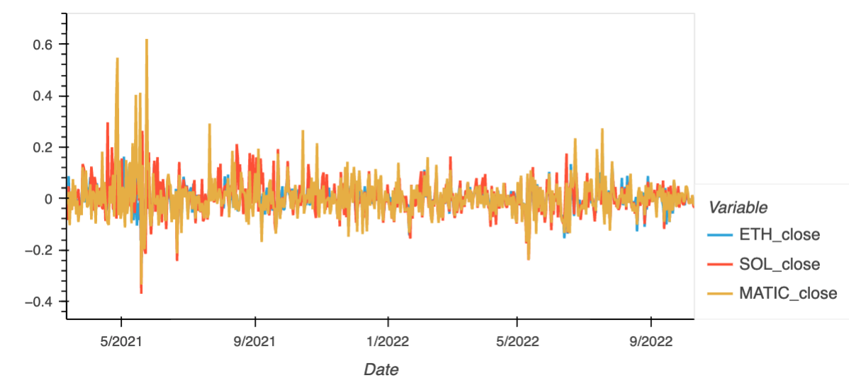
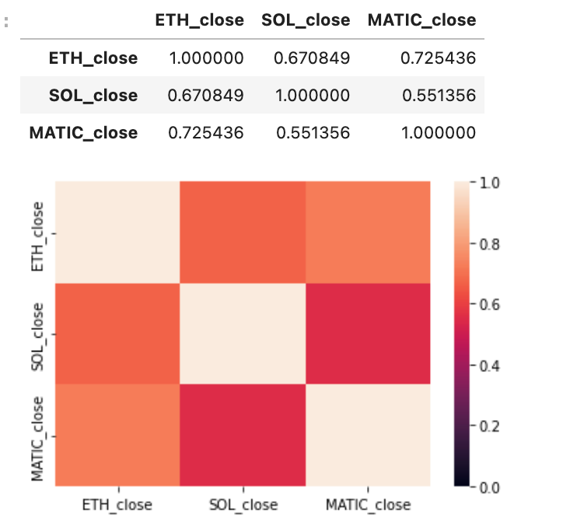
CO-RELATION of BASKETS - CHAIN

Slide 12
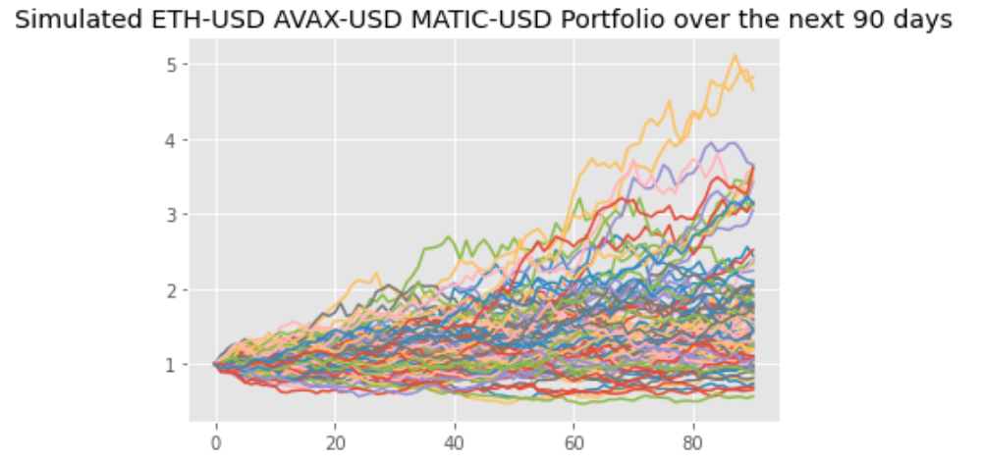
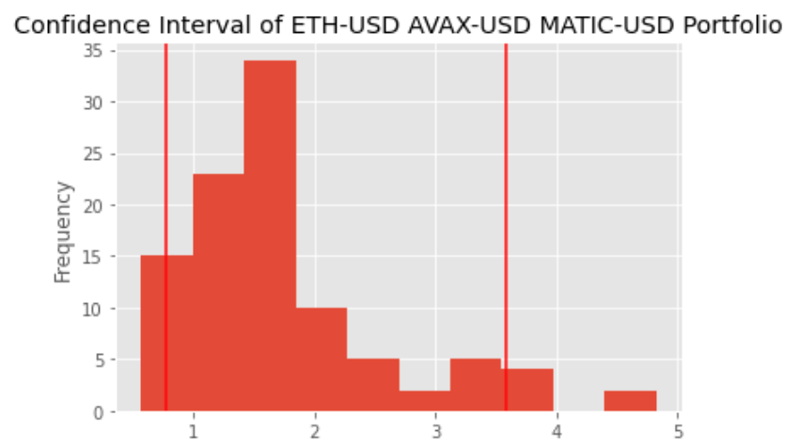
RISK ANALYSIS - CHIAN

Slide 13
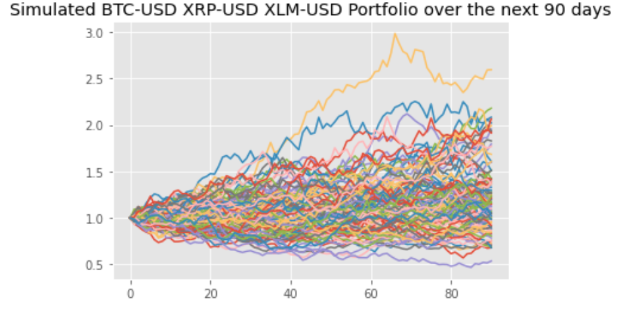
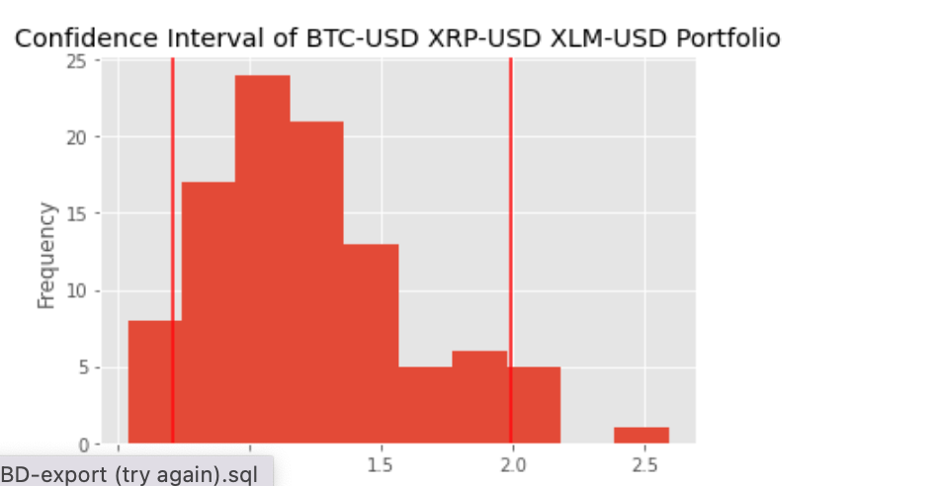
RISK ANALYSIS - COIN

Slide 14
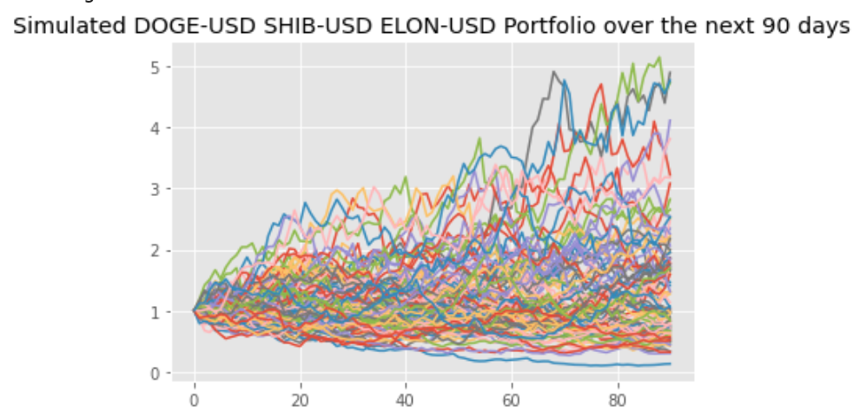
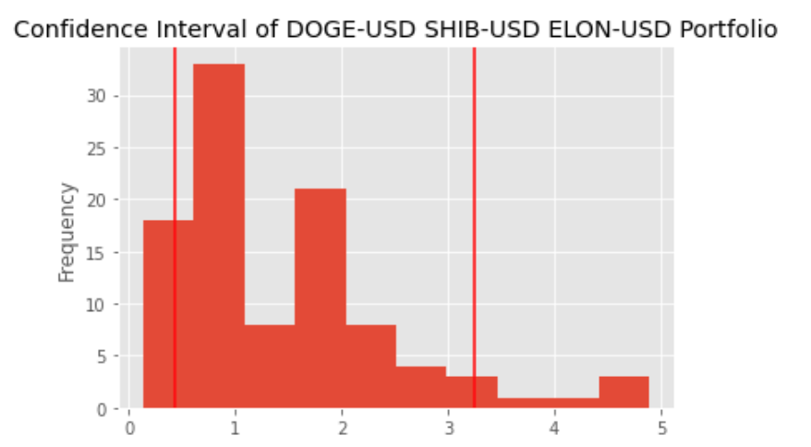
RISK ANALYSIS -MEME

Slide 15
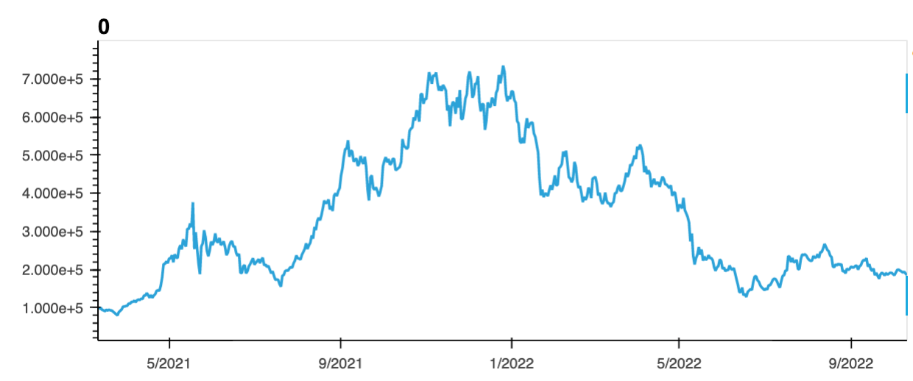
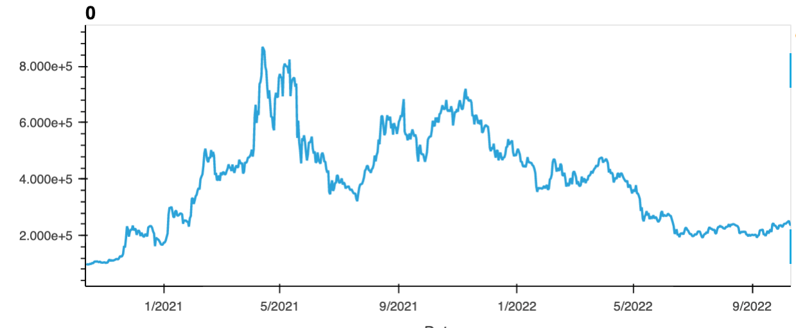
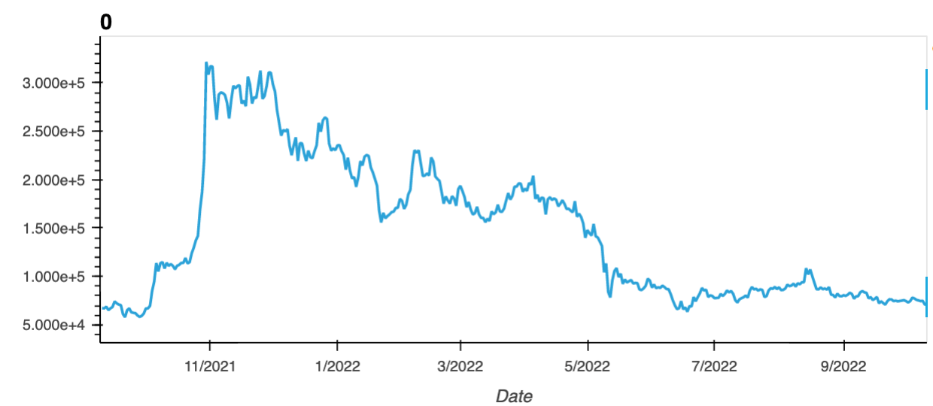
CUmulative RETURNS
COINS
CHAINS
MEMES

Slide 16
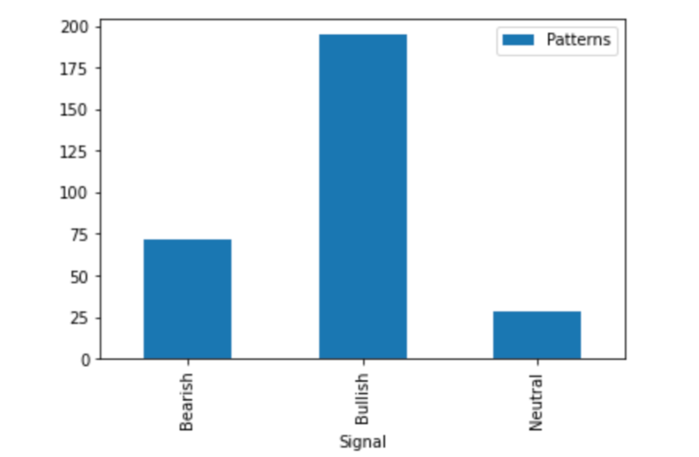
RECOGINIZED PATTERNS
CDLHIGHWAVE - High-Wave Candle
CDLHIKKAKE - Hikkake Pattern
CDLHIKKAKEMOD - Modified Hikkake Pattern
CDLHOMINGPIGEON - Homing Pigeon
CDLIDENTICAL3CROWS - Identical Three Crows
CDLINNECK - In-Neck Pattern
CDLINVERTEDHAMMER - Inverted Hammer
CDLKICKING - Kicking
CDLKICKINGBYLENGTH - Kicking - bull/bear determined by the longer marubozu
CDLLADDERBOTTOM - Ladder Bottom
CDLLONGLEGGEDDOJI - Long Legged Doji
CDLLONGLINE - Long Line Candle
CDLMARUBOZU - Marubozu
CDLMATCHINGLOW - Matching Low
CDLMATHOLD - Mat Hold
CDLMORNINGDOJISTAR - Morning Doji Star
CDLMORNINGSTAR - Morning Star
CDLONNECK - On-Neck Pattern
CDLPIERCING - Piercing Pattern
CDLRICKSHAWMAN - Rickshaw Man
CDLRISEFALL3METHODS - Rising/Falling Three Methods
CDLSEPARATINGLINES - Separating Lines
CDLSHOOTINGSTAR - Shooting Star
CDLSHORTLINE - Short Line Candle
CDLSPINNINGTOP - Spinning Top
CDLSTALLEDPATTERN - Stalled Pattern
CDLSTICKSANDWICH - Stick Sandwich
CDLTAKURI - Takuri (Dragonfly Doji with very long lower shadow)
CDLTASUKIGAP - Tasuki Gap
CDLTHRUSTING - Thrusting Pattern
CDLTRISTAR - Tristar Pattern
CDL2CROWS - Two Crows
CDL3BLACKCROWS - Three Black Crows
CDL3INSIDE - Three Inside Up/Down
CDL3LINESTRIKE - Three-Line Strike
CDL3OUTSIDE - Three Outside Up/Down
CDL3STARSINSOUTH - Three Stars In The South
CDL3WHITESOLDIERS - Three Advancing White Soldiers
CDLABANDONEDBABY - Abandoned Baby
CDLADVANCEBLOCK - Advance Block
CDLBELTHOLD - Belt-hold
CDLBREAKAWAY - Breakaway
CDLCLOSINGMARUBOZU - Closing Marubozu
CDLCONCEALBABYSWALL - Concealing Baby Swallow
CDLCOUNTERATTACK - Counterattack
CDLDARKCLOUDCOVER - Dark Cloud Cover
CDLDOJI - Doji
CDLDOJISTAR - Doji Star
CDLDRAGONFLYDOJI - Dragonfly Doji
CDLENGULFING - Engulfing Pattern
CDLEVENINGDOJISTAR - Evening Doji Star
CDLEVENINGSTAR - Evening Star
CDLGAPSIDESIDEWHITE - Up/Down-gap side-by-side white lines
CDLGRAVESTONEDOJI - Gravestone Doji
CDLHAMMER - Hammer
CDLHANGINGMAN - Hanging Man
CDLHARAMI - Harami Pattern
CDLHARAMICROSS - Harami Cross Pattern
CDLUNIQUE3RIVER - Unique 3 River
CDLUPSIDEGAP2CROWS - Upside Gap Two Crows
CDLXSIDEGAP3METHODS - Upside/Downside Gap Three Methods

Slide 17
CONCLUSION
Build triggers based on BEAR & BULL PATTERNS
Compare historical data with buy & hold strategy in relation to bot based strategy.
Implement risk portfolio selection based on monte carlos simulations since there is a strong corelation based on our analysis.

